Slide 1
Space-Efficient Algorithms for Longest Increasing Subsequence
Masashi Kiyomi, Hirotaka Ono, Yota Otachi, Pascal Schweitzer, Jun Tarui
Theory of Computing Systems 64, pp.522-541, 2020
Presenter: Zhi-Cheng Shen
Date: June.13, 2023

Slide 2
Abstract
Given a sequence of integers, we want to find a longest increasing subsequence of the sequence. It is known that this problem can be solved in O(n log n) time and space. Our goal in this paper is to reduce the space consumption while keeping the time complexity small. For √ n ≤ s ≤ n, we present algorithms that use O(s log n) bits and
O( 1/s · n² · logn) time for computing the length of a longest increasing subsequence, and O( 1/s · n² · log²n) time for finding an actual subsequence. We also show that the time complexity of our algorithms is optimal up to polylogarithmic factors in the framework of sequential access algorithms with the prescribed amount of space.

Slide 3
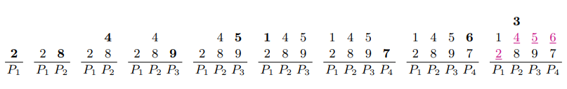
Patience Sorting
S₁ = <2, 8, 4, 9, 5, 1, 7, 6, 3>
Lis(S₁) = 4

Slide 4
Time & Space Complexity
Time: O(nlogn)
Space: O(nlogn) bits of working space

Slide 5
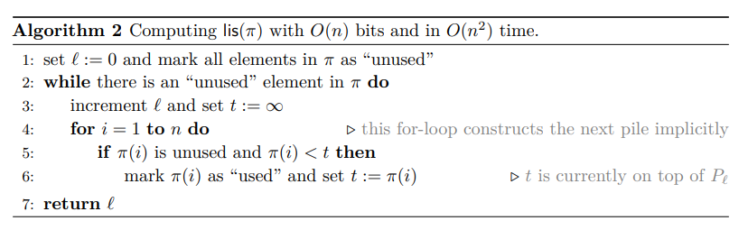
Correctness of Patience Sorting

Slide 6
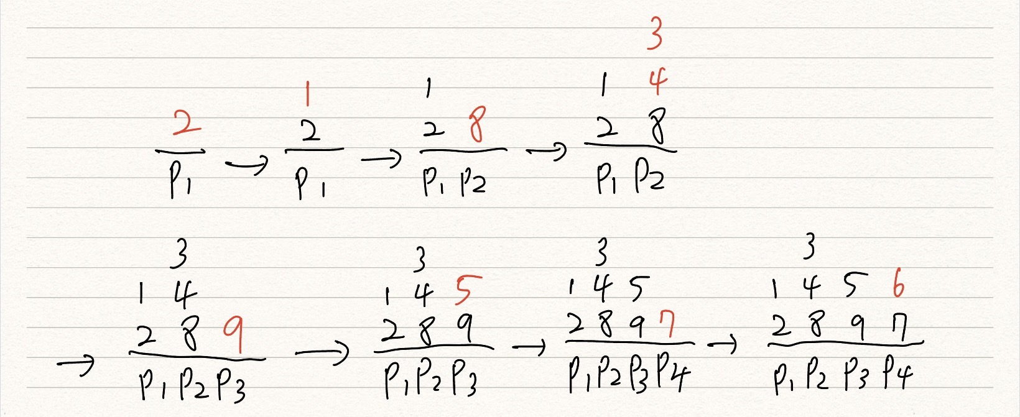
S₁ = <2, 8, 4, 9, 5, 1, 7, 6, 3> Lis(S₁) = 4

Slide 7
Time & Space complexity
Time: O(n²)
Space: O(nlogn) bits for working space

Slide 8
A Simple O(n) Bits Algorithm
S₁ = <2,6,4,7,5,1,8,9,3,10,11,12,13,14,7> S₆ = <10,11,12,13,14>
P₁ = 2,1 P₆ = 10
S₂ = <6,4,7,5,8,9,3,10,11,12,13,14,7> S₇ = <11,12,13,14>
P₂ = 6,4,3 P₇ = 11
S₃ = <7,5,8,9,10,11,12,13,14,7> S₈ = <12,13,14>
P₃ = 7,5 P₈ = 12
S₄ = <8,9,10,11,12,13,14,7> S₉ = <13,14>
P₄ = 8,7 P₉ = 13
S₅ = <9,10,11,12,13,14> S₁₀ = <14>
P₅ = 9 P₁₀ = 14

Slide 9
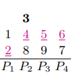
S₁ = <2, 8, 4, 9, 5, 1, 7, 6, 3> P₁ = 2,1
S₂ = <8,4,9,5,7,6,3>
P₂ = 8,4,3
S₃ = <9,5,7,6>
P₃ = 9,5
S₄ = <7,6>
P₄ = 7,6

Slide 10
Main Algorithm
Given an integer s satisfying n^{1/2} <= s <= n
It scans over the input O(n/s) times
In each pass, it assumes that a pile P_{i} with at most s elements is given, which has been computed in the previous pass. Using this pile P_{i}, it filters out the elements in the previous piles P₁, . . . , P_{i-1}.
As a result of the pass, it computes a new pile P_{j} with at most s elements such that j ≥ i + s.

Slide 11
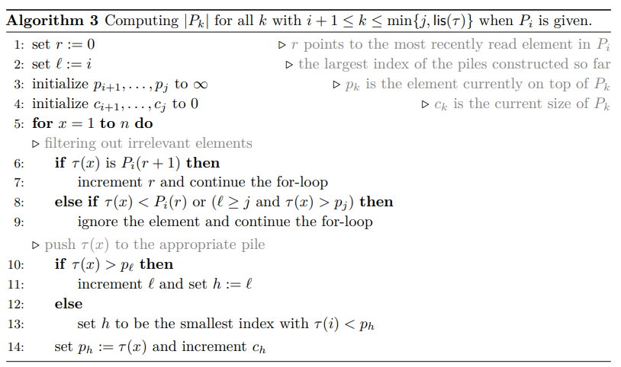
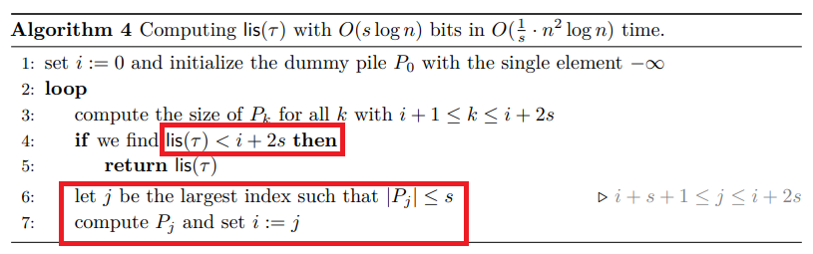
Main Algorithm

Slide 12
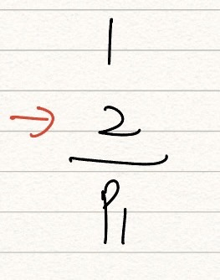
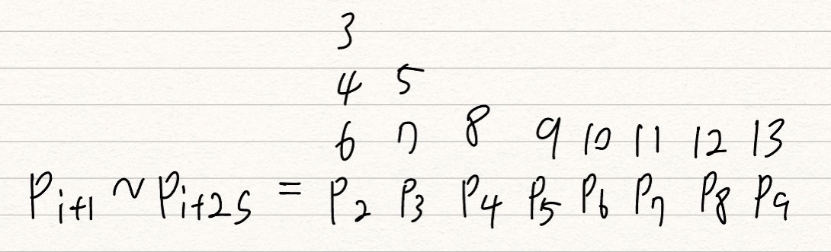
S₁ = <2,6,4,7,5,1,8,9,3,10,11,12,13,14,7>
LIS = <2,4,5,8,9,10,11,12,13,14>
LIS(S₁) = 10
Let n = 15, i = 1, s = 4
P₁ = (2,1)
S₂ = <6,4,7,5,8,9,3,10,11,12,13,14,7>

Slide 13
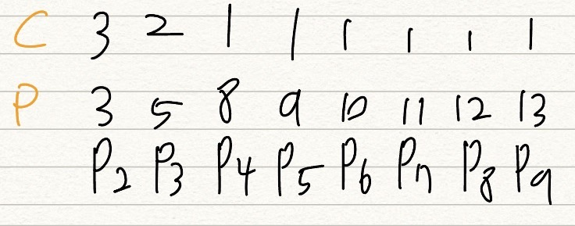
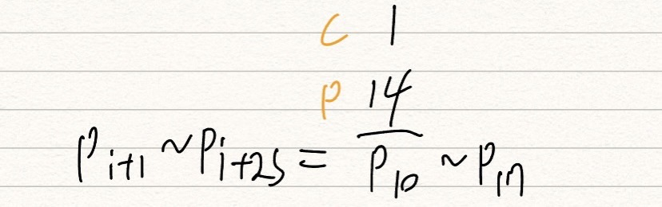
P₉ = (13)
T₃ = <14>

Slide 14
Time & Space Complexity
Time: each iteration need O(nlogn), it scans input (n/s) time,
so O(nlogn) * (n/s) = O(1/s * n²logn)
Space: O(slogn) bits for working space, because (i+2s) – (i+1) = O(s)

Slide 15
Thanks~

